Slide 1

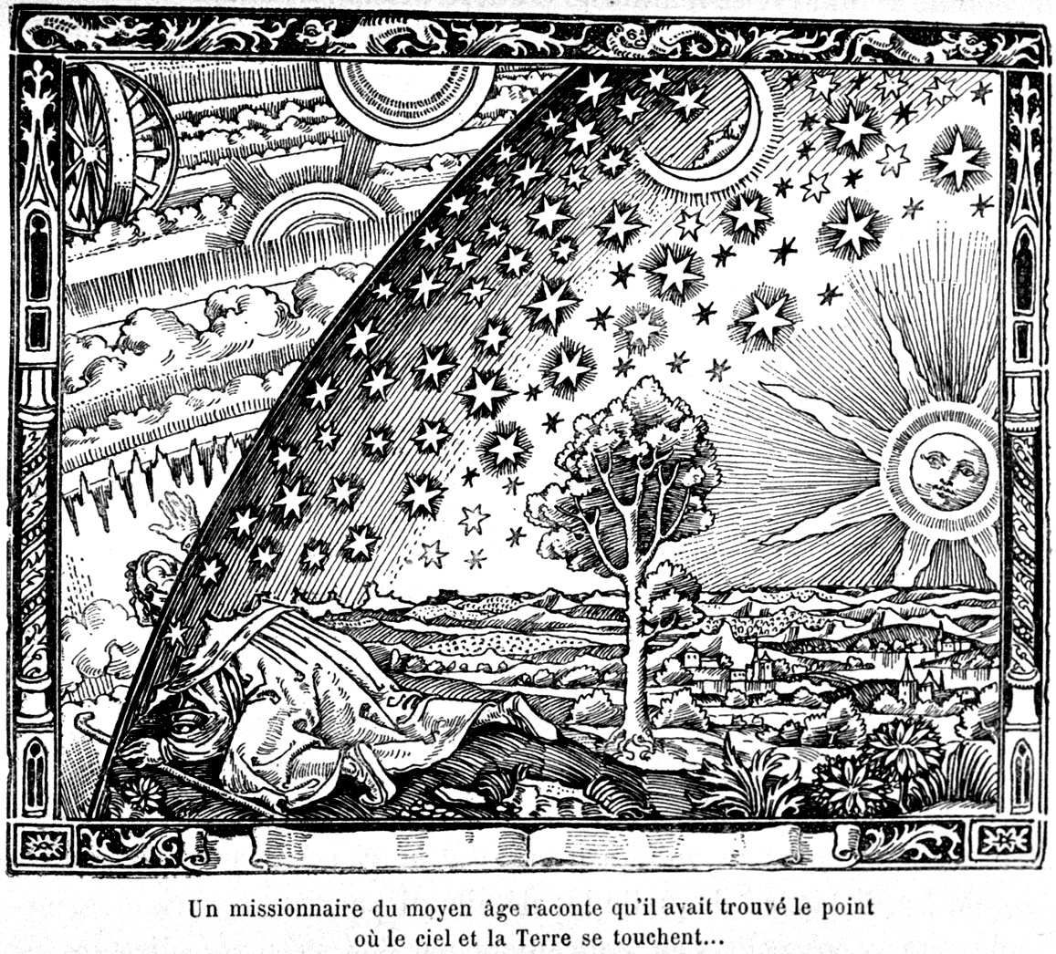
The New Biology:
Implications for Philosophy, Theology and Education

Slide 2
RE Lessons

Slide 3
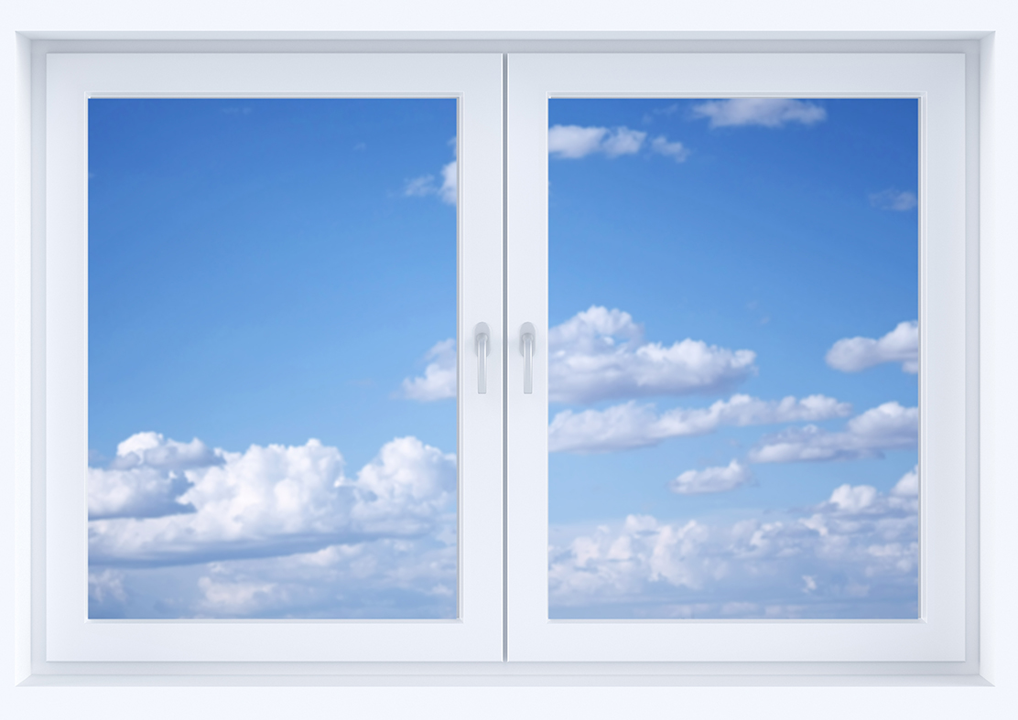
Lesson 1
Religion and Science: Two Windows?

Slide 4
In 2000, scientist Professor Freeman Dyson was awarded the Templeton Science and Religion prize. In his acceptance speech, he stated:
“Science and religion are two windows that people look through, trying to understand the big universe outside, trying to understand why we are here.”

Slide 5
In 2000, scientist Professor Freeman Dyson was awarded the Templeton Science and Religion prize. In his acceptance speech, he stated:
“Science and religion are two windows that people look through, trying to understand the big universe outside, trying to understand why we are here.”
Does this capture the way an atheist might view the universe?
Does it capture the way you view the universe?
Give examples of how it does and does not capture the way you view the universe.
Do you look through alternative windows?

Slide 6
In groups, design a diagram which presents:
A definition of science
A definition of religion
The relationship between science and religion
Challenge
You could also try to incorporate the following in your diagram:
What we can know and understand through science, if anything
What we can know and understand through religion, if anything

Slide 7
In the same speech, Dyson says:
“Both views are one-sided, neither is complete. Both leave out essential features of the real world. And both are worthy of respect.”
What does this mean? Do you agree?
What do you think Dyson thinks about religion and science?
Do these ideas raise any questions for us to consider in future lessons?

Slide 8
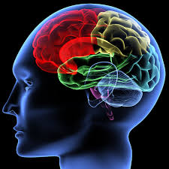
Lesson 2
Can we survive death?

Slide 9
Have ‘you’ survived the brain transplant? If so, have you survived death?
Is this a brain transplant or a body transplant, or both?
What does the narrative suggest about what it means to survive death? What is your response to this?
Are you now Maria, or are you the ‘ original’ you, or both?
What is a person and what aspect(s) of a person could survive death?
What (if anything) would you like to survive of you? Why?
What other questions/comments about the nature of personhood and the belief that we can survive death do you have?

Slide 10
Should we look to science or religion, or both, to define personhood? Why?
Should we use science or religion, or both, to find out if we can survive death? Why?

Slide 11
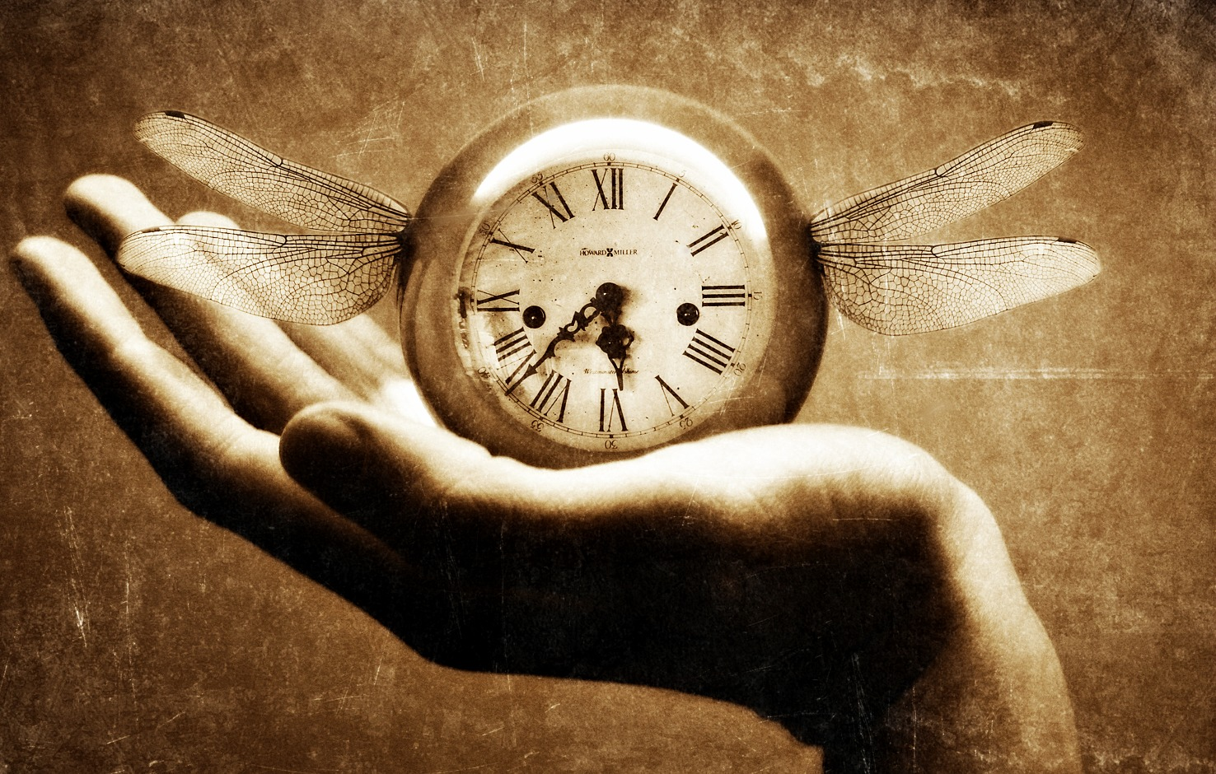
Lesson 3
Soul Survivor?

Slide 12
The video tells us that Macdougall attempted to weigh the soul but it does not tell us what the soul is.
  What do you think the soul is?
  Do you think Macdougall’s experiment was a good way of finding out about the existence of the soul?
  Why/Why not?

Slide 13
Example of a consolidation table
Summary of Argument | For or against existence of the soul? | What is the evidence? | Why is this evidence believable? | Strengths and weaknesses of argument | Similar examples and/or questions

Slide 14
When looking at evidence and arguments about the existence of the soul:
What are the qualities and characteristics of strong evidence and argument? What kinds of evidence and argument are worthy of serious consideration? Why?
What are the qualities and characteristics of weak evidence and argument? What kinds of evidence and argument should be rejected? Why?
How do science and religion affect how you think about these questions?

Slide 15
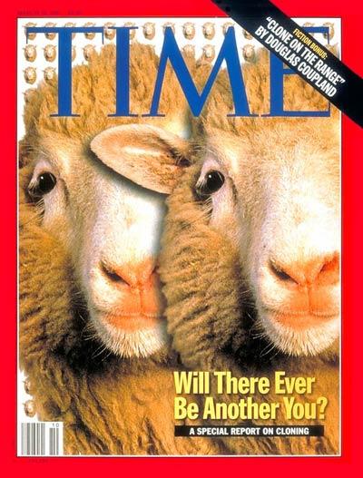
Lesson 4
Ethics of Cloning

Slide 16
When does life begin? Who/what decides this?
When does life end? Who/what decides this?

Slide 17
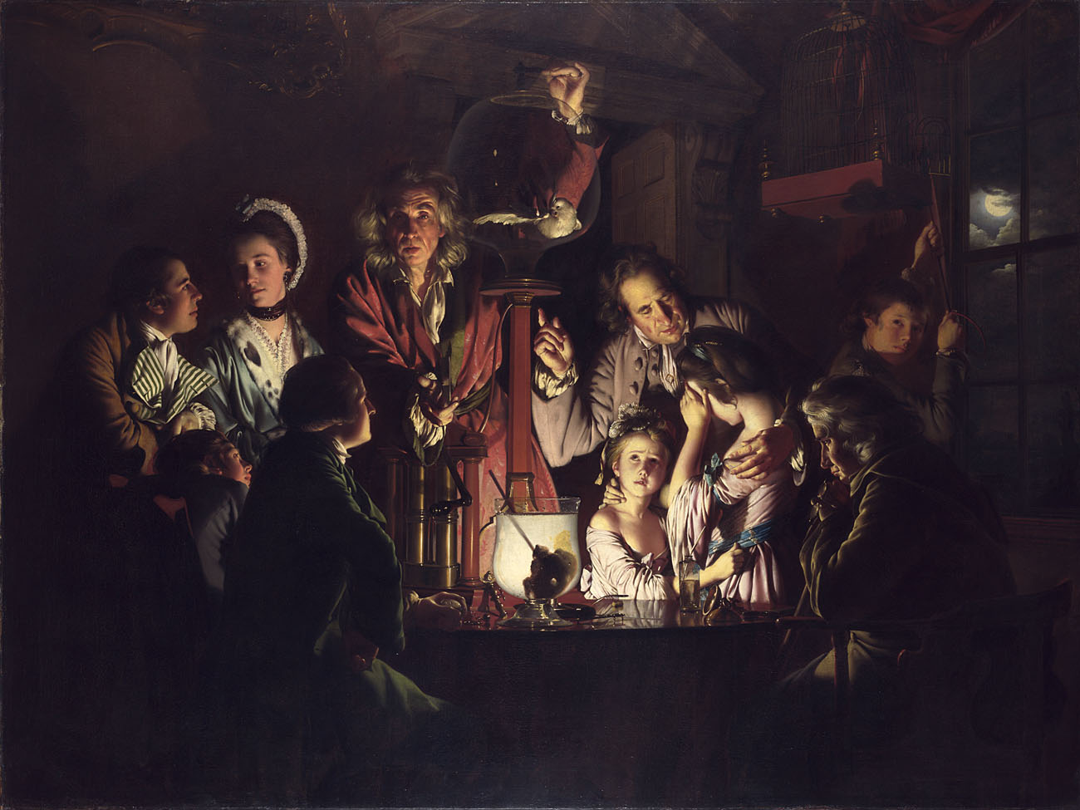

Slide 18
‘An Experiment on a Bird in the Air Pump’
Joseph Wright 'of Derby‘ 1768

Slide 19
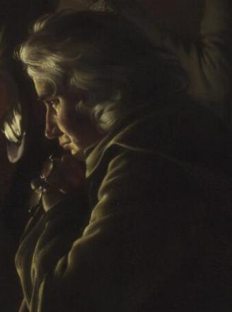
The bird doesn’t deserve to die just to prove that oxygen exists.
What will this mean for my children?
This is just as I planned. Now the children can actually SEE what I have been telling them is true.
Life isn’t a mystery anymore. We survive because we breathe oxygen.
Plain and simple.

Slide 20
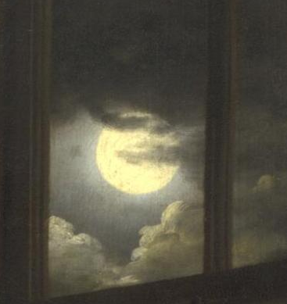
The moon might represent…
The clouds reveal the moon to show….
or
The clouds hide the moon to show…

Slide 21
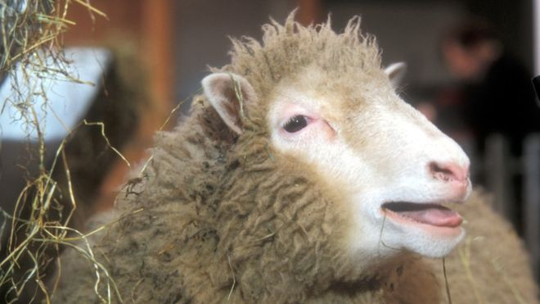
How is the case of Dolly the sheep similar and/or different to the scene in the painting?

Slide 22
Which character is likely to hold your quotation as true?
Please be ready to explain your thinking.

Slide 23
Lesson 5
Seeing is believing?

Slide 25
Category | Who/ What? | How/Why do I know or believe this? | Example
Family | Parents | They love me. They want what’s best for me. | Don’t put your hand in the fire.
Friends
School
Media
Government
Faith or non-faith perspective

Slide 26
How and why might these sources of authority change over time?

Slide 27
What are the advantages and disadvantages to being in only one or both worlds?

Slide 28
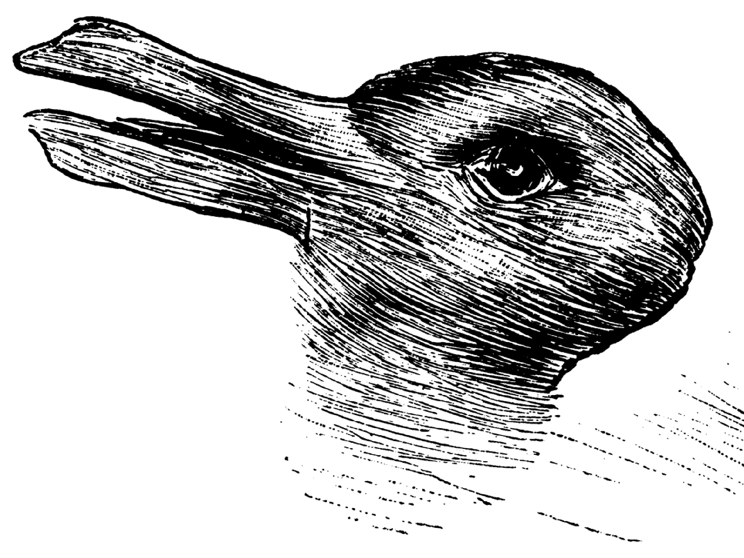
Duck or rabbit?

Slide 29
How are the images similar?
How are they different?
What can they tell us about knowledge and belief?

Slide 30
Lesson 6
What is the relationship between science and religion? Does it matter?

Slide 31
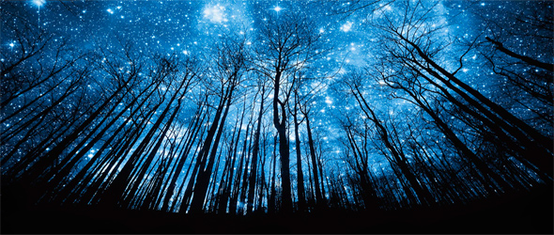
Is it relevant to study the relationship between science and religion?
Is it important?
Why? Why not?

Slide 32
Thank you
UCL Institute of Education
University College London
20 Bedford Way
London WC1H 0AL
Tel +44 (0)20 7612 6000
Fax +44 (0)20 7612 6126
Email info@ioe.ac.uk
Web www.ucl.ac.uk/ioe

